Slide 1
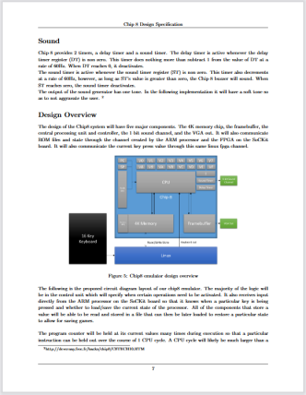
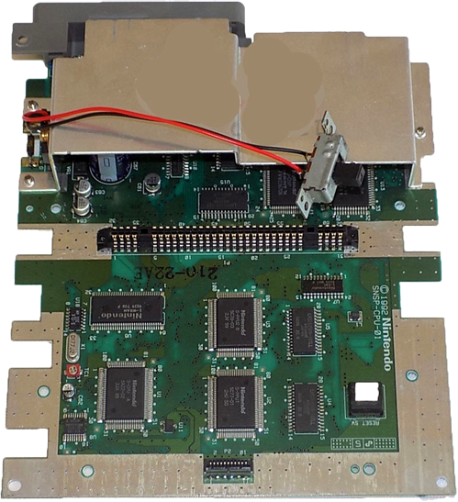
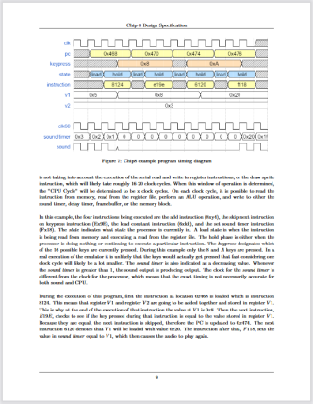
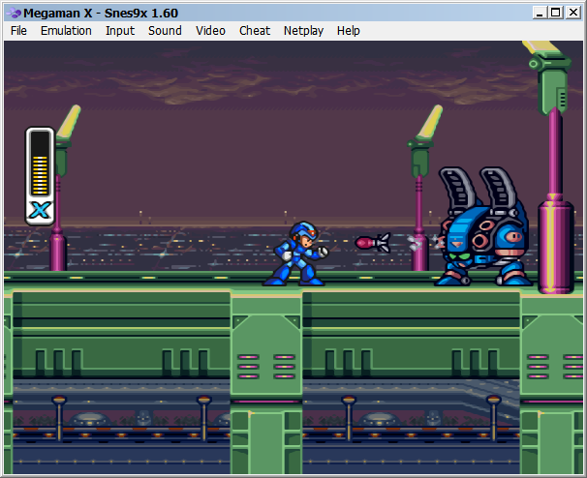
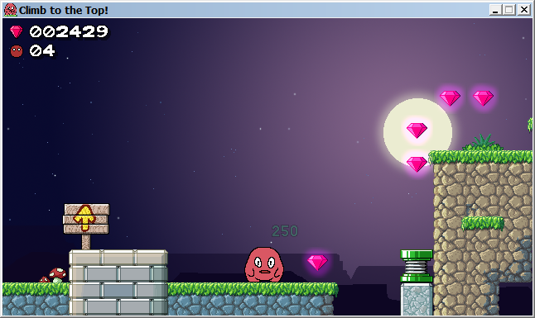
Physical machine
An already existing console
Emulated machine
A program that imitates a console
Made up machine
A new console created from scratch
How it works, and what it can do, are given by
its components
How it works is given by the
the original machine
How it works is given by its design documents

Slide 2
outputs
Screen
Speakers
removable storage
Vircon32
console
On/Off switch
Cartridge
Reset button
Memory Card
external
signals
inputs
4 Gamepads

Slide 3
Console
CPU
Video chip
Sound chip
words
pixels
samples
Cartridge (ROM file)
Program ROM
(code + data)
Video ROM
(images)
Audio ROM
(sounds)

Slide 4
outputs
Screen
Speakers
removable storage
Control logic
(affects all components)
Video chip
Sound chip
BIOS
On/Off switch
Timer
CPU
Cartridge controller
Cartridge
Reset button
Random number generator
Memory Card
Memory card controller
external
signals
Gamepad controller
RAM memory
inputs
4 Gamepads

Slide 5
RAM memory
BIOS
Cartridge controller
Mem. card controller
CPU
Request
Memory bus (Addresses)
Response

Slide 6
Graphics chip
Sound chip
Gamepad controller
Timer
CPU
Request
Control bus (I/O ports)
Response
Random number generator
Cartridge controller
Mem. card controller

Slide 7
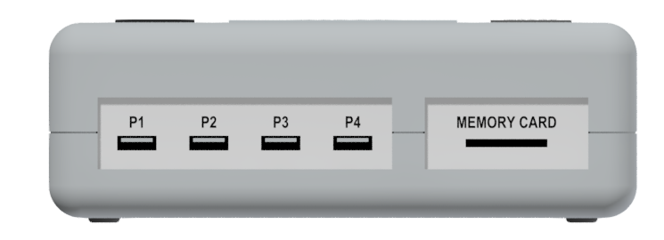
4 ports
(P1 to P4)
0
1
2
3
selected gamepad

Slide 8
Sign
+
It is pressed
Read button ‘A’
20
Value
20
Pressed for 20 frames

Slide 9
(0, 0)
Constant
color
Red = 197
Green = 224
Blue = 180
Alpha = 255
(639, 359)

Slide 10
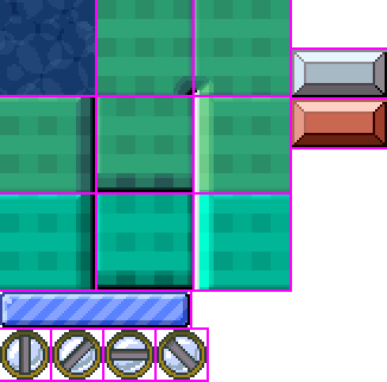
(0, 0)
Texture used by the GPU
Image stored in the cartridge
(1023, 1023)

Slide 11
-1
0
1
2
3
...
selected texture

Slide 12
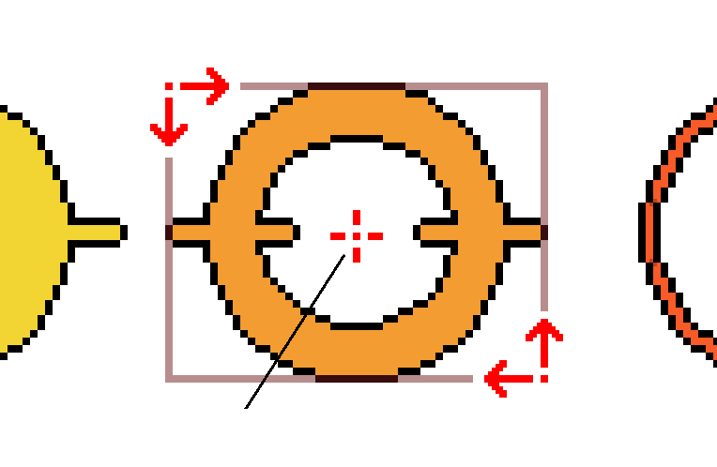
1) Top-Left corner
3) Reference point
2) Bottom-right corner

Slide 13

(0, 0)
x = 320
y = 180
(639, 359)

Slide 14

Scale in X = 0.7, in Y = 3

Slide 15
Rotation = -30º

Slide 16
Remove red component

Slide 17




Alpha
blending_alpha
Add
blending_add
Subtract
blending_subtract

Slide 18
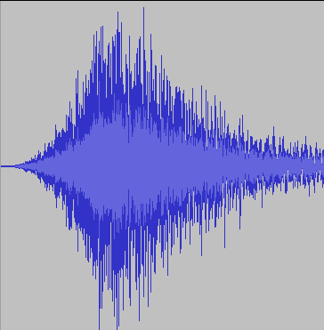
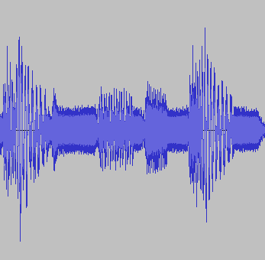
16 sound channels
List of game
sounds
0
Sound assigned to the channel
1
(inactive)
2
(inactivo)
3
(inactive)
…

Slide 19
Unmodified
Volume = 1.8
Unmodified
Speed = 2.0

Slide 20
Position before jump
Jump target position
Skipped
Played
before jump
Played
after jump

Slide 21
start position
end position
Initially
While loop
remains enabled
If loop gets disabled

